Slide 1
For over 20 years we at 4C Strategies have delivered software and supporting expert services globally to build resilient organizations and train for the future.
4C Strategies
Interim Report Q2 2024
Risk Management
Business Continuity Management
Incident & Crisis Management
Training & Exercise Management
July 19, 2024
STOCKHOLM | LONDON | WASHINGTON D.C. | BRISBANE MALMÖ | ORLANDO | WARMINSTER

Slide 2
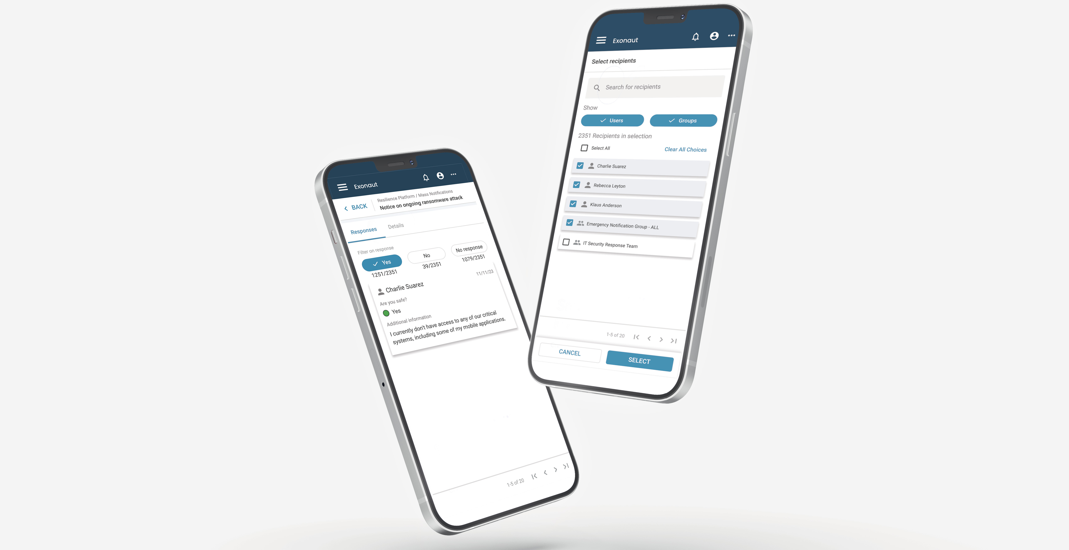
4C for Public and Corporate customers
Pain points
Complex risk exposure in all organisations
Increased regulatory requirements
Low tolerance for disruption
Lack of digitalization and integration
Impact
Better prepared organization
Improved decision making and understanding
Regulatory compliance and automated reporting
Cost savings and increased shareholder value

Slide 3
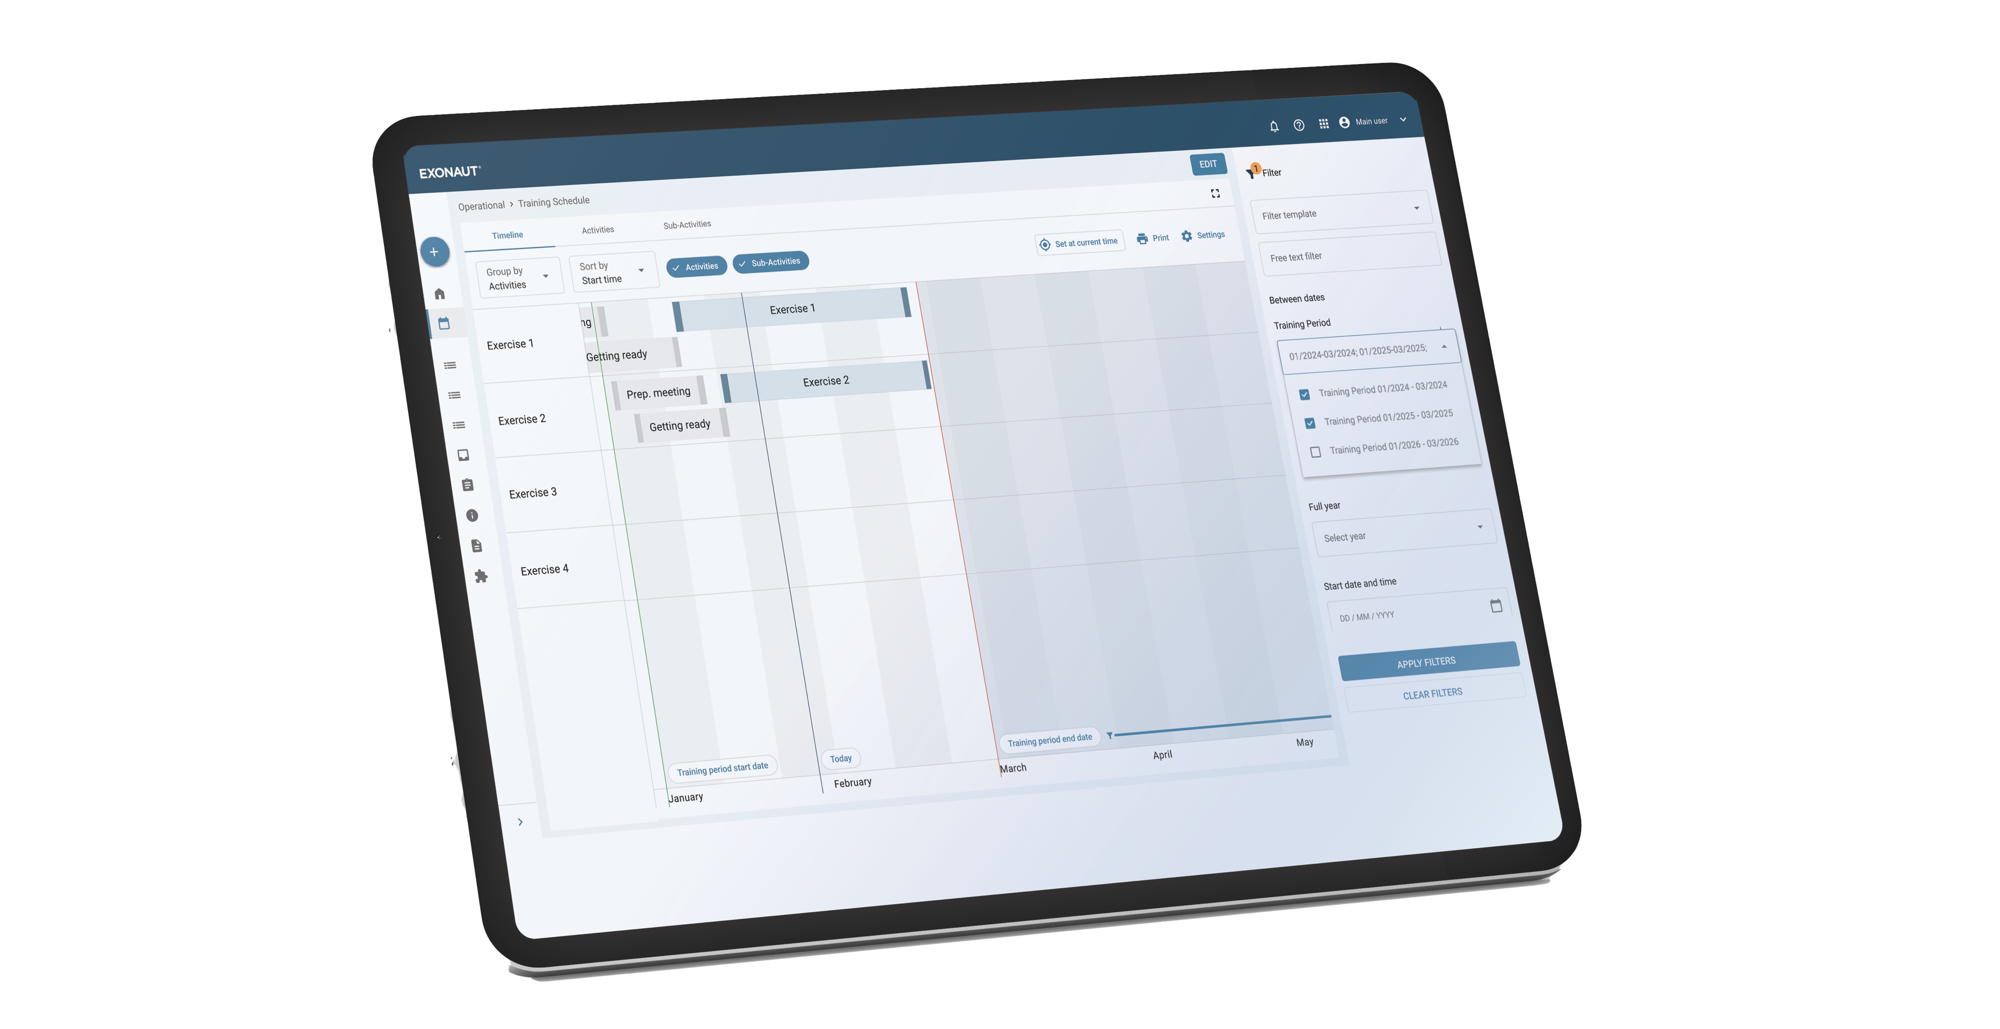
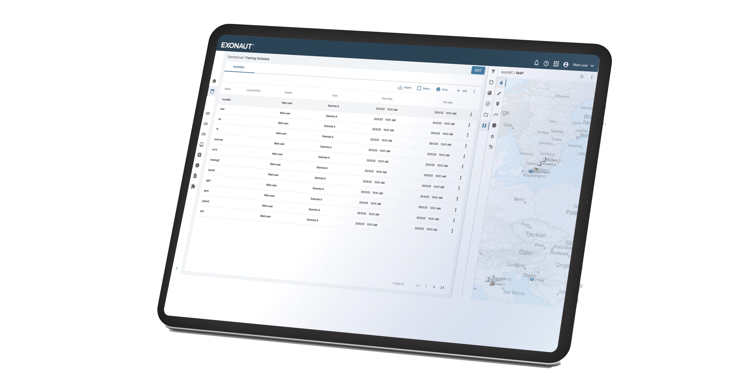
4C for Defence Customers
Pain points
Global demand for rapid build up in military readiness – not just equipment
Increased cost of military training
High scrutiny on defence spending
Impact
More trained units with improved capabilities
Greater visibility of readiness on all levels
Increased visibility between spend and generated effects

Slide 4
Optimizing
for the future
4C STRATEGIES
APAC
EMEA
Streamline our business
Improve follow-up and optimization
New segment reporting starting from the third quarter
North America
Expert Services
Notes:
These are the highflying benefits of utilizing Exonaut, digital first approach to a crisis. Focus more on the points highlighted by earlier in the conversation when discussing their needs for a solution.

Slide 5
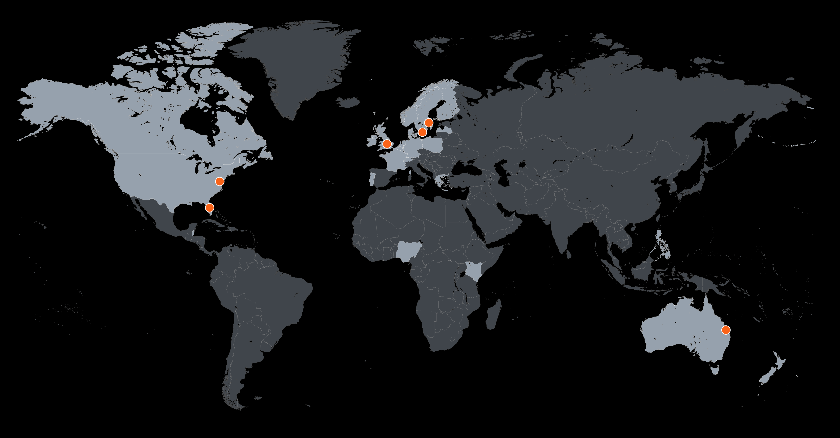
Executive summary Q2 2024
Financials
Net sales (MSEK)
Software revenue
Adjusted EBIT margin*
Q2 2024
60.5
62%
-54%
Q2 2024 YTD
136.2
59%
-36%
Delayed contracts in North America, now in final stages.
Nordics maintained consistent activity and growth; International saw strong performance in Australia with new defence contracts.
Management and operational changes to enhance efficiency implemented
4C in numbers
136
Net sales 2024 H1
14%
Net sales CAGR 2020-2024 Q2
28
New clients
H1 2024
STOCKHOLM | LONDON | WASHINGTON, D.C. | BRISBANE
MALMÖ | ORLANDO | WARMINSTER
*EBIT adjusted for items affecting comparability (IPO-related costs)

Slide 6
Net sales per segment, RTM

Slide 7
North America
Contract delays in North America defence persist.
Key contracts in final negotiations, expected to significantly impact 2024 results.
Growing pipeline in defence and corporate segment.

Slide 8
Nordics
Strategic projects with major government and private clients extended, offering good prospects for a strong 2024.
Over 10 new customers for software and expert services signed in both private and public sectors, strengthening our position in the Nordic market.

Slide 9
International
Strong performance in APAC with strategic extensions, and key contract expansions in the defence segment.
Positive pipeline development in Europe and NATO.
New agreements with UK Royal Air Force and Royal Navy align with our strategy to broaden defence offerings.

Slide 10
Key Priorities
Notes:
These are the highflying benefits of utilizing Exonaut, digital first approach to a crisis. Focus more on the points highlighted by earlier in the conversation when discussing their needs for a solution.

Slide 11
Three key focus areas
Drive organization to regain lost ground and deliver a strong 2024
Focus on exceptional customer service and enhanced product delivery
Continued Technical Innovation and transformation through AI and key additions to our team

Slide 12
Q&A
Notes:
These are the highflying benefits of utilizing Exonaut, digital first approach to a crisis. Focus more on the points highlighted by earlier in the conversation when discussing their needs for a solution.

Slide 13
Thank you
Be Ready. Be Resilient. Foresee.
Upcoming reports:
Interim Report Q3 2024: October 31, 2024

