Slide 1
Kambi Group plc
Q3 report 2017

Slide 2
Agenda
Kambi overview & highlights
Financial update
Customer signings
Customer extensions and launches
Kambi initiatives
Summary
Q&A

Slide 3










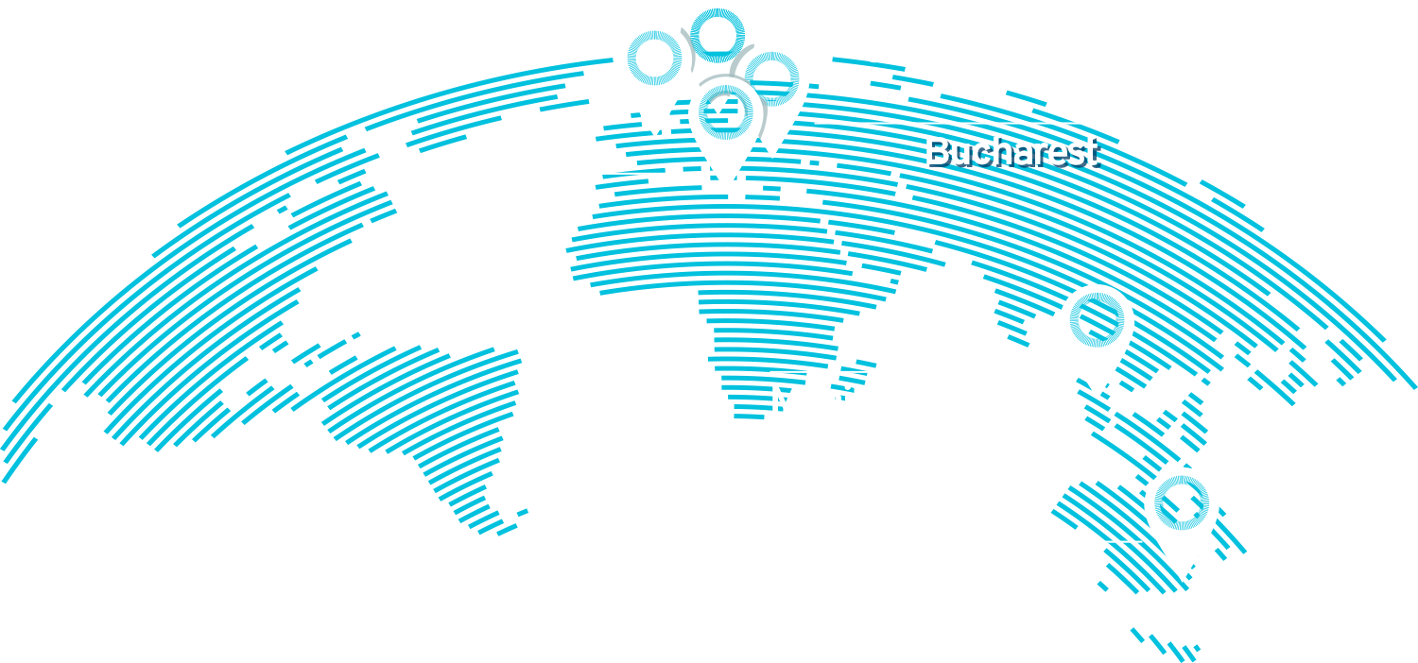






Kambi overview
Turnkey sports betting service
602
Employees
across six offices

Slide 4
Highlights and key events
Continued strong performance with operator turnover growth of 16% and a high trading margin of 7.5%
New customer agreement signed with Bulgaria’s National Lottery AD, 7777.bg and extended contracts with Paf and LeoVegas
New customer launches for Greentube, PlayCity and BetPlay
Six Kambi powered operators recognised by eGaming Review (EGR) Power 50 list
7.5%
Trading margin

Slide 5
Financial headlines
Q3 2017
Q3 2016

Slide 6
Operator trading analysis
Kambi’s operators' turnover & trading margin
Operator turnover increased by 16% compared to Q3 2016
Typical seasonal turnover trend
Q3 trading margin of 7.5% , brings YTD to 6.6%

Slide 7
Growth in operator turnover and Kambi revenue
Q3 2017 vs Q3 2016

Slide 8
Income statement
€m | Q3 2017 | Q3 2016 | Jan-Sep 2017 | Jan-Sep 2016
Revenue | 14.8 | 14.8 | 43.1 | 41.7
Operating expenses | 13.7 | 11.7 | 40.4 | 34.7
Operating result | 1.1 | 3.1 | 2.7 | 7.0
Result after tax | 0.8 | 2.7 | 2.0 | 6.3

Slide 9
Cash flow
€ ‘000

Slide 10
Kambi signed a multi-year contract with National Lottery AD
Bulgaria’s largest privately held gaming operator
Kambi to provide its premium sports betting service to the 7777.bg brand
Expected to launch in Q4 2017
National Lottery AD has a customer base in excess of two million

Slide 11


Kambi extends contracts with LeoVegas and Paf
Kambi extends contracts with LeoVegas and Paf
Both operators will continue to leverage Kambi’s operator empowerment capabilities
Three key customers have re-signed in the last two quarters showing the stability and strength of the Kambi Sportsbook
The signed extensions further demonstrate the strength of Kambi’s partnerships

Slide 12




New customer launches
Televisa launched its PlayCity online Sportsbook in the Mexican market
Corredor Empresarial set to unveil its Kambi-powered BetPlay brand to the Colombian market
Kambi’s exposure to Latin America expanded
Greentube launched in Italy and Romania
Greentube
Mexico
Colombia

Slide 13

Kambi initiatives
Kambi’s Distinctive Capability
Kambi’s distinct capability is its unique capacity to build a scalable and high-performing Sportsbook core
This empowers Kambi customers to differentiate their product to meet their own individual strategies
This approach allows Kambi to future-proof operators’ Sportsbooks and offer a competitive proposition

Slide 14

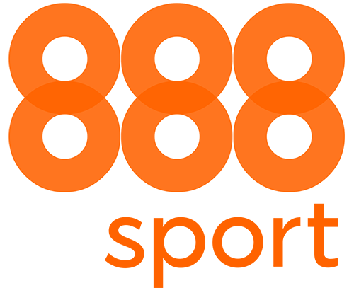



EGR Power 50 2017
EGR published its Power 50 rankings, a list comprising the biggest and most influential online gaming operators
Six Kambi operators are ranked in the top 40, with two in the top ten
This is recognition of Kambi’s Sportsbook quality service and operator performance.

Slide 15
Summary
Revenues on a par with last year’s quarter, despite tough comparatives
Continuing to secure existing revenue base with another two key operator extensions
Confident Kambi is well positioned for long-term revenue growth

Slide 16
Q&A

Slide 17
Thank you

